Slide 1

ICD007 Web Technologies
Andrew & Sunday

Slide 2
Outline for today’s session
Overview of HTML, MYSQL and PHP
Introduction to MySQL and SQL [Database and language]
SQL Syntax
Basic MySQL Operations
Assembling Tables (hands-on)
Handling Data (More later in course)
LAB:
Connecting to PHP to save and retrieve data from MySQL

Slide 3
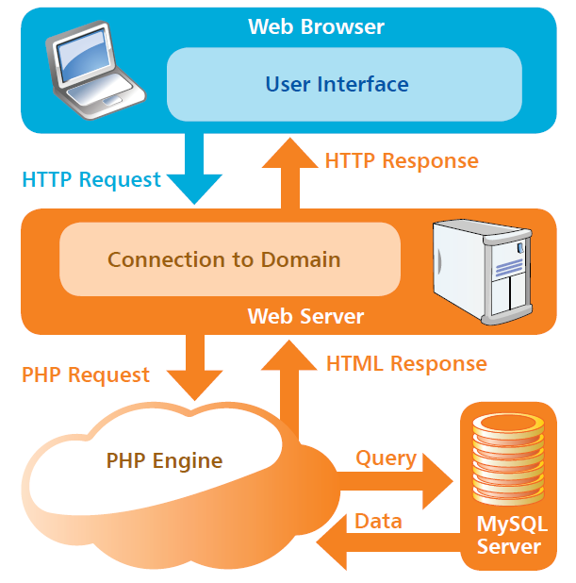
HTML, MYSQL and PHP

Slide 4
What is a database

Slide 5
MYSQL & SQL Database & Language
What is a Database?
A database is just a repository in which you can store information, add some layer of organization to the stored information and grab information when needed.
A file cabinet is an example of a database. You can throw things into it, pull those things back out and even use files and labels to keep your files organized.

Slide 6
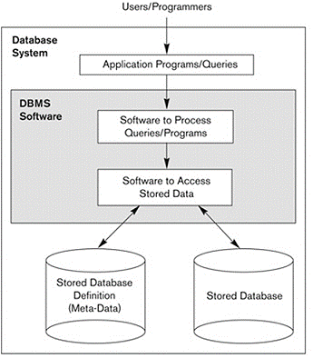
MYSQL & SQL: Database Environment
Databases are created, maintained, and manipulated using programs called database management systems (DBMS) sometimes referred to as database software.
Key terminologies include:
Table or File – Refers to a list of data. A database is either a single table or a collection of related tables.
Column or Field - defines the data that a table can hold. A database with a “Students” table columns shows the data under that column or field
Row or Record - represents a single instance of whatever the table keeps track of.
Key - is the field used to relate tables in a database. E.g., STUDENT_ID key. There is one unique attribute for each item in the database. For e.g a one to many relationships among the keys in tables.

Slide 7
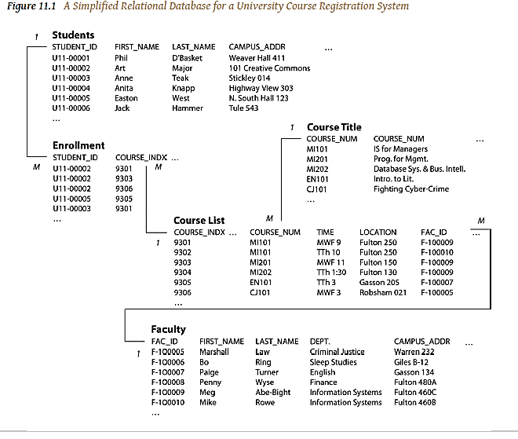
Sample relational Database

Slide 8
MYSQL & SQL Various Procedures carried out in DBMS
1. Defining of a database
Entity test | Attribute | Data types | Constraints (limitations)
Employee | Emp_name | Char (40) | Alphabet Only
 | Emp_id | Num (6) | Val>0
 | Emp_add | Char (100) | -
 | Emp_desig | Char (15) | -
 | Emp_dept | Char (10) | Alphabet Only
 | Emp_Sal | Number (10.2) | Val>0
The process of specifying the data types, structures and constraints is called Defining the database

Slide 9
MYSQL & SQL Various Procedures carried out in DBMS
2. Construct the database
Emp_name | Emp_id * | Emp_addr | Emp_desig | Emp_Sal
Kristjan | 100 | Kadriog tee 58, Tallinn | Senior Information Officer | 40,000
Pauline | 101 | #12 Akadeemia tee, Tallinn | Project Accountant | 42,000
Camille | 102 | # 202 Kadaka tee, Tallinn | Design Architect | 20,000
Melissa | 103 | # 500 Sauna tee, Tallinn | Cloud Solutions Expert | 25,000
The process of storing the data on some storage medium

Slide 10
MYSQL & SQL Various Procedures carried out in DBMS
3. Manipulate the database
E.g. for some queries
List all employees whose salaries are greater than 20,000
List all employees whose names start with “P”
Delete records whose Emp_name is Melissa
Manipulating the Database-involves the retrieval (activity of finding) of required data and modifying it depending on the requirement. E.g. EMPLOYEE database –

Slide 11
MYSQL & SQL Types of DB Users
Database Administrator [DBA]
Database Designers [DBD]
End Users
System Analysts and Application Programmers
DBMS System Designers and Implementers
Tool Developers

Slide 12
MYSQL & SQL Database & Language
Databases are Persistent
By now, you know that PHP gives you arrays that serve as (sort of) a programmer’s cabinet. Arrays can hold multiple values, etc. But, an array might function as a database in a simplistic sense, yet cannot serve actual needs for long.
Arrays and their contents in PHP are lost every time your program stops and starts again.
For example, if you loop through an associative array using a foreach loop, like below:

Slide 13
MYSQL & SQL Database & Language
Databases are Persistent
<?php $age = array("Peter"=>"35", "Ben"=>"37", "Joe"=>"43"); foreach($age as $x => $x_value) { echo "Key=" . $x . ", Value=" . $x_value; echo "<br>"; } ?>
A good database provides long-term storage for your information, and needs to store information more permanently. This is the concept of persistence.
source

Slide 14
MYSQL & SQL Database & Language
Is Permanent Data really Permanent?
Databases can be destroyed. This is why back-up and replication are crucial.
Back-up is just creating a copy of your database so that if something goes wrong, you can restore the database from the back-up and recover all (or at least most) of the information lost.
Replication is when an entire database is duplicated (the duplicated version might be running simultaneously)

Slide 15
MYSQL & SQL Database & Language
Good Databases are relational
A good database both creates and manages all relationships. Relationships are so integral to MySQL and other DBMSs.
This simply means in addition to instructing a database what information you want it to store for you, you also define how that information is connected to other pieces of information

Slide 16
MYSQL & SQL Database & Language
Objects and Relations in Databases
A RDMS stores information in tables, rows and columns. Anything that is stored in the RDBMS involves some kind of mapping. This means that information in your PHP script has to be mapped to particular tables and columns.
E.g., the information in $_REQUEST[‘first_name’] variable needs to be stored in the Users table, and then in the first_name column.
Its not so simplistic in OODBMS, you have to create an object in your code and hand over to the OODBMS which will figure out how to deal with an object instead of you specifying where pieces of information go.

Slide 17
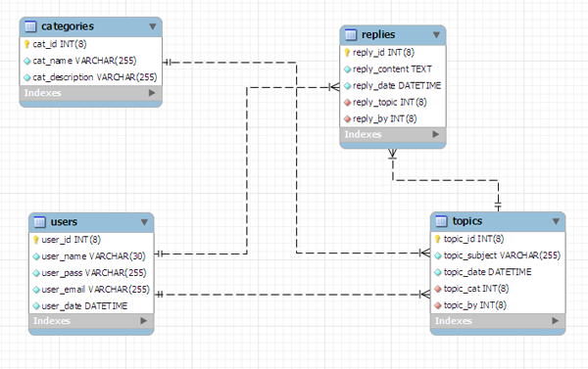
Here is a database of a forum which has users who create topics in various categories. Other users can post replies. The lines between them represent entity relationships.
Creating a good data model

Slide 18
MYSQL & SQL Database & Language
Installing MySQL
You already set up the Dev Environment in the last class (or rather before), since you received the link to set up already.
If you didn’t, see:
https://github.com/ICD0007/php-lab-one/blob/master/dev-env-setup.md

Slide 19
MYSQL [Database]
MySQL is the most popular Open Source Relational SQL database management system.
MySQL is one of the best RDBMS being used for developing web-based software applications.
SQL is a standard language for accessing databases.

Slide 20
SQL is database language

Slide 21
SQL [language]
Structured Query language is used for programming databases. It is sometimes called “Sequel”
The history of SQL began in an IBM laboratory in San Jose, California, where SQL was developed in the late 1970’s.
SQL stands for structured Query Language. It is a non-procedural language, meaning that SQL describes what data to retrieve, delete or insert, rather than how to perform the operation.
It is the standard command set used to communicate with RDBMS.

Slide 22
SQL
An SQL query is not-necessarily a question to the database.
It can be a command to do one of the following.
Create or delete a table.
Insert, modify or delete rows.
Search several rows for specifying information and return the result in order.
Modify security information, etc.

Slide 23
SQL
An SQL query is not-necessarily a question to the database.
It can be a command to do one of the following.
Create or delete a table.
Insert, modify or delete rows.
Search several rows for specifying information and return the result in order.
Modify security information, etc.

Slide 24
SQL
Semicolon is the standard way to separate each SQL statement in database systems that allow more than one SQL statement to be executed in the same call to the server.

Slide 25
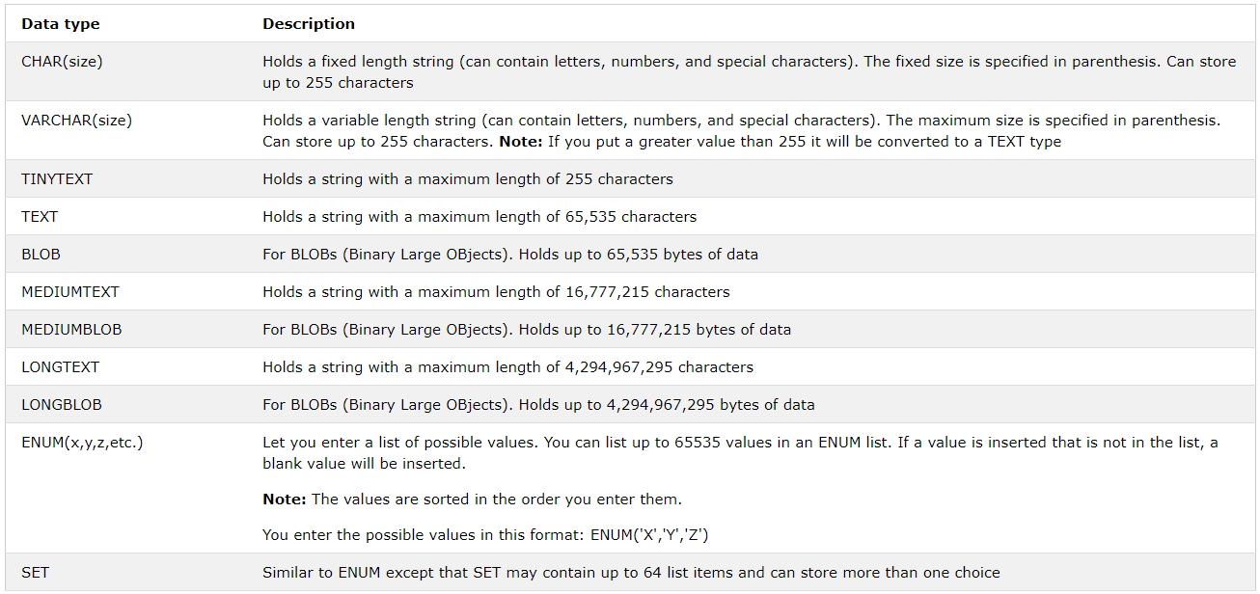
SQL Data Types

Slide 26
SQL
The SQL Statements can be grouped into the following Categories.
DDL(Data Definition Language)
DML(Data Manipulation Language)
DCL(Data Control Language)
TCL(Transaction Control Language)

Slide 27
SQL
DDL: Data Definition Language
The DDL statement provides commands for defining relation schema i.e., for creating tables, indexes, sequences etc. and commands for dropping, altering, renaming objects.
DML: (Data Manipulation Language)
The DML statements are used to alter the database tables in someway. The UPDATE, INSERT and DELETE statements alter existing rows in database tables, insert new records into a database table, or remove one or more records from the database table.
DCL: (Data Control Language)
The Data Control Language Statements are used to Grant permission to the user and Revoke permission from the user, Lock certain Permission for the user.
SQL DBA>Revoke Import from Fredi;
SQL DBA>Grant all on EMP to public;
SQL DBA>Grant select, Update on EMP to Selim;
SQL DBA>Grant ALL on EMP to Anna with Grant option;
Revoke: Revoke takes out privilege from one or more tables or views.
SQL DBA>REVOKE, UPDATE, DELETE FROM USERS;
SQL DBA>Revoke all on EMP from Eveillard
TCL: (Transaction Control Language)
It is used to control transactions. Eg: Commit
Rollback: Discard/Cancel the changes up to the previous commit point.

Slide 28
Basic SQL Operations (CRUD)
Some of The Most Important SQL Commands
SELECT - extracts data from a database
UPDATE - updates data in a database
DELETE - deletes data from a database
INSERT INTO - inserts new data into a database
CREATE DATABASE - creates a new database
ALTER DATABASE - modifies a database
CREATE TABLE - creates a new table
ALTER TABLE - modifies a table
DROP TABLE - deletes a table
CREATE INDEX - creates an index (search key)
DROP INDEX - deletes an index
source
CRUD is simply CREATE, READ, UPDATE and DELETE. A CRUD application uses forms to get data into and out of a database.

Slide 29
Basic SQL Operations (Examples)
Create a database: CREATE DATABASE my_db;
Create table:
CREATE TABLE table_name(
column_name1 data_type(size),
column_name2 data_type(size),
column_name3 data_type(size),
....
) ;
Select from a table in database: SELECT column_name,column_name FROM table_name; Or SELECT * FROM table_name ;

Slide 30
Basic SQL Operations (Examples)
Insert to a table: INSERT INTO table_name VALUES (value1,value2,value3,...); OR INSERT INTO table_name (column1,column2,column3,...) VALUES (value1,value2,value3,...);
Drop Database: DROP DATABASE database_name
Truncate a table: TRUNCATE TABLE table_name
Update a table: UPDATE table_name SET column1=value1,column2=value2,... WHERE some_column=some_value;
Delete: DELETE FROM table_name WHERE some_column=some_value;

Slide 31
SQL Operations (Examples)
Alter a table: ALTER TABLE table_name ADD column_name datatype

Slide 32
SQL CREATE TABLE + CONSTRAINT Syntax
CREATE TABLE table_name( column_name1 data_type(size) constraint_name, column_name2 data_type(size) constraint_name, column_name3 data_type(size) constraint_name, .... );
NOT NULL - Indicates that a column cannot store NULL value ( i.e., a blank field)
UNIQUE - Ensures that each row for a column must have a unique value
PRIMARY KEY - A combination of a NOT NULL and UNIQUE. Ensures that a column (or combination of two or more columns) have a unique identity which helps to find a particular record in a table more easily and quickly
FOREIGN KEY - Ensure the referential integrity of the data in one table to match values in another table
CHECK - Ensures that the value in a column meets a specific condition
DEFAULT - Specifies a default value for a column

Slide 33
SQL Functions
SQL has many built-in functions for performing calculations on data.
AVG() - Returns the average value
COUNT() - Returns the number of rows
FIRST() - Returns the first value
LAST() - Returns the last value
MAX() - Returns the largest value
MIN() - Returns the smallest value
SUM() - Returns the sum

Slide 34
Hands-on

Slide 35
Assembling Tables (Intro)
Introducing Tables
Creating Tables
Defining data types
Adding modifiers
Setting primary keys
Altering tables
Inserting data
Updating columns
Updating fields

Slide 36
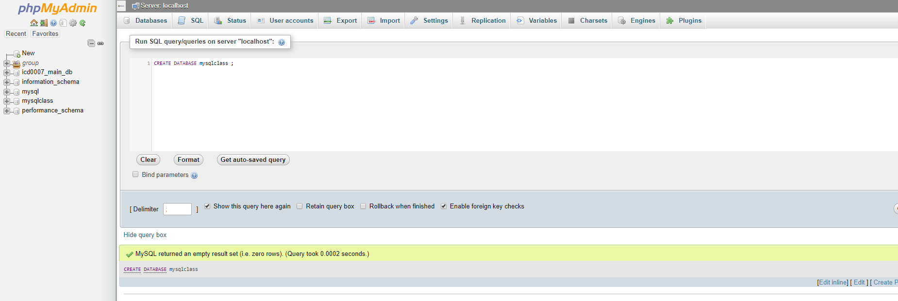
First create a database

Slide 37
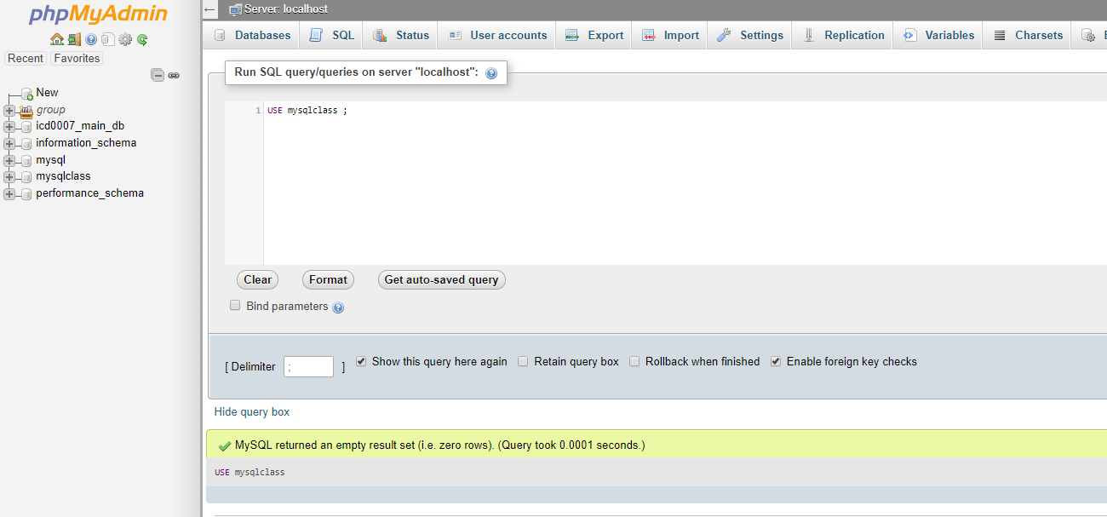
USE database

Slide 38
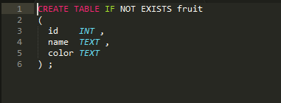
Creating Tables

Slide 39
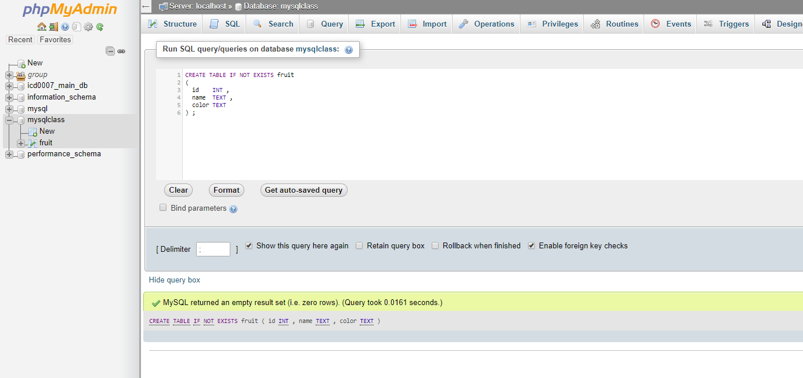
Creating tables (without defining parameters)

Slide 40
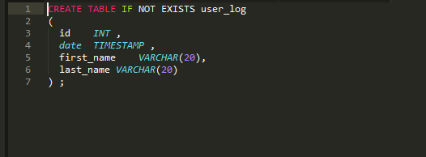
Defining data types

Slide 41
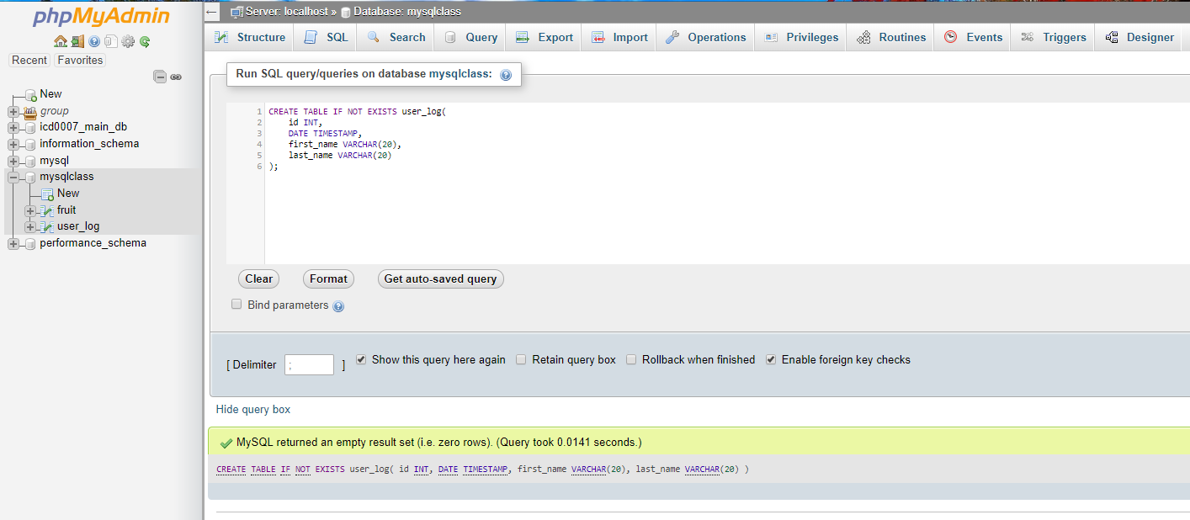
Defining data types

Slide 42
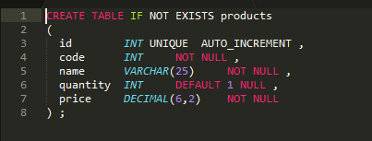
Adding Modifiers

Slide 43
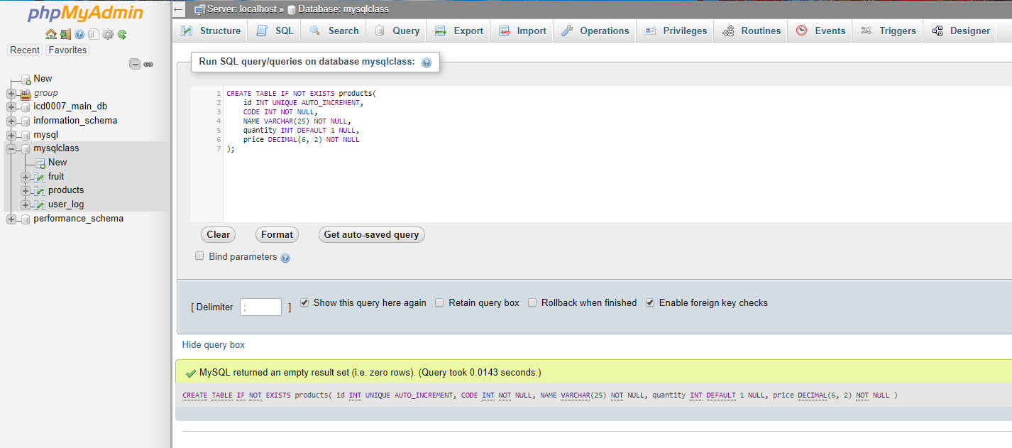
Adding Modifiers

Slide 44
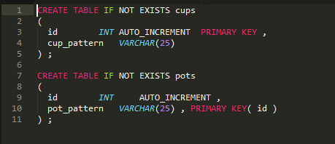
Setting Primary Keys

Slide 45
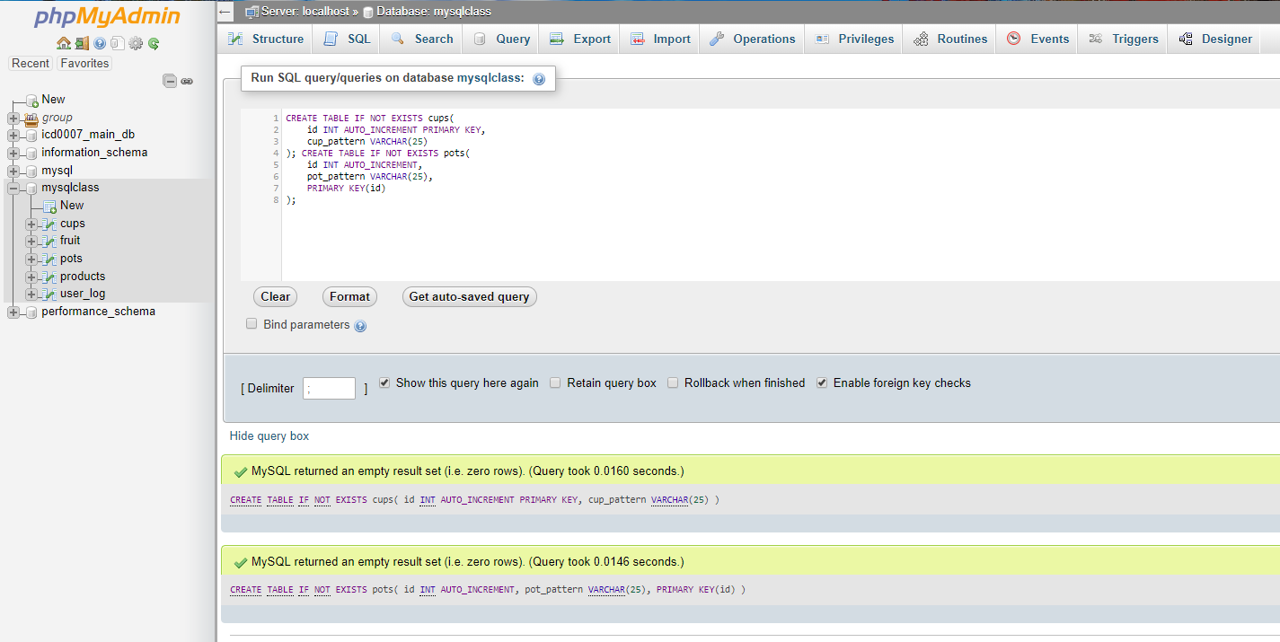
Setting Primary Keys

Slide 46
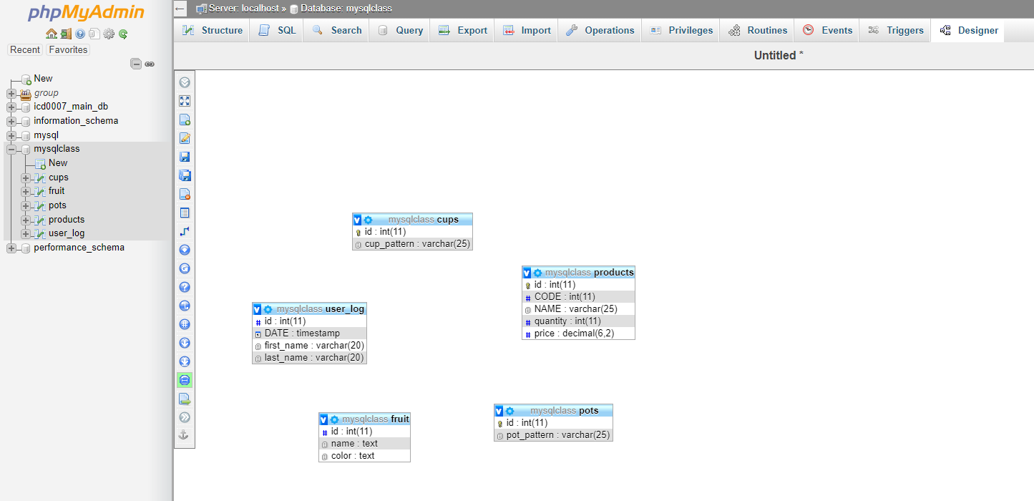
The schema so far

Slide 47
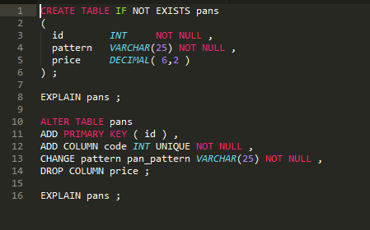
Altering tables

Slide 48
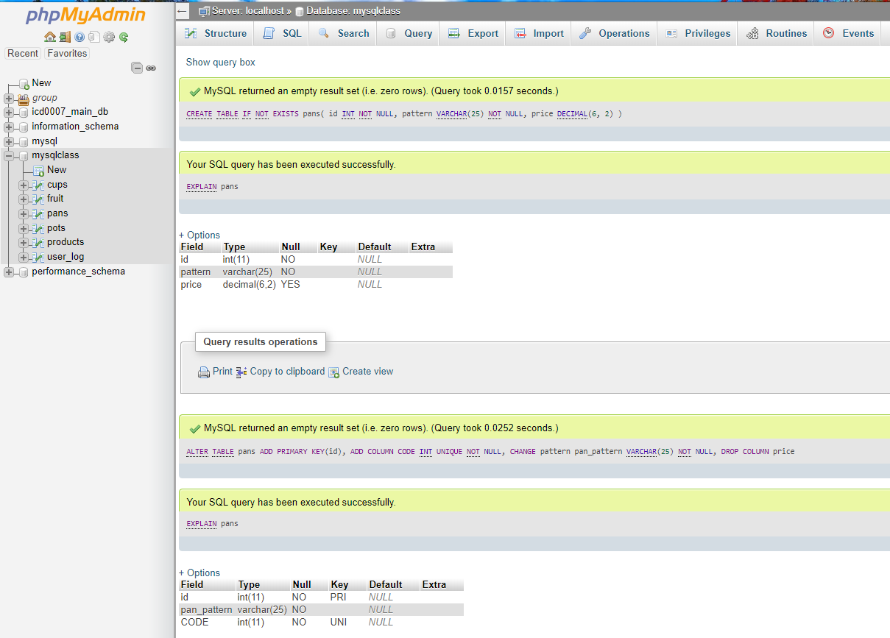
Altering tables

Slide 49
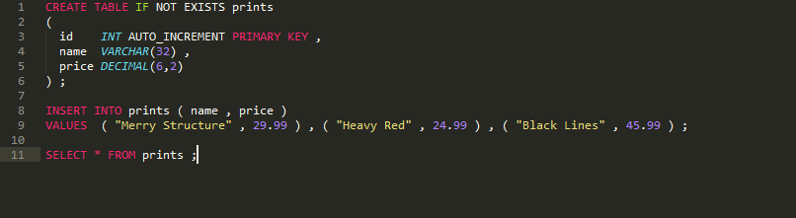
Inserting data

Slide 50
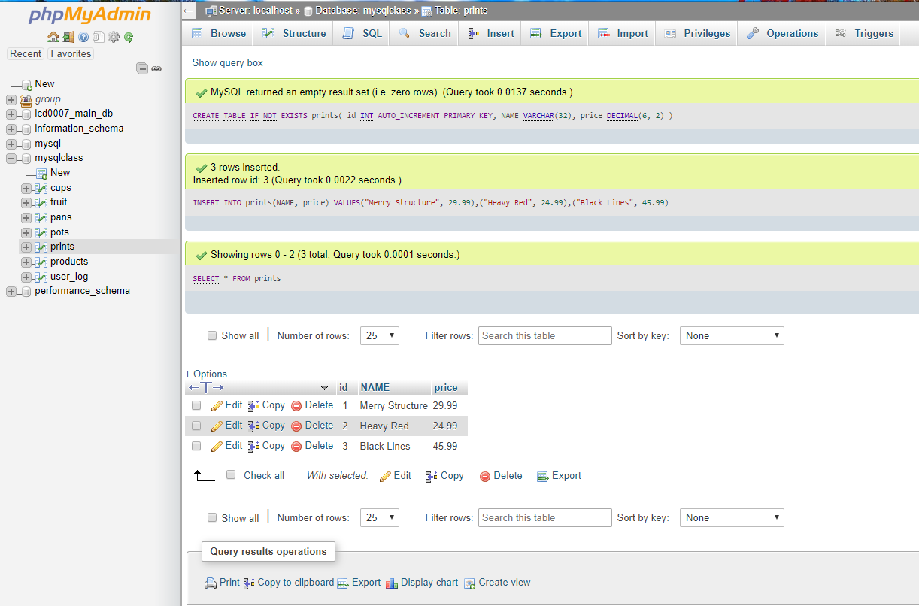
Inserting data

Slide 51
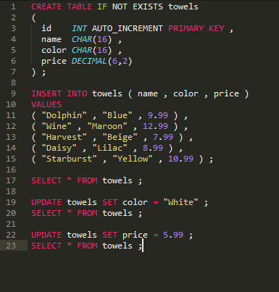
Updating columns

Slide 52
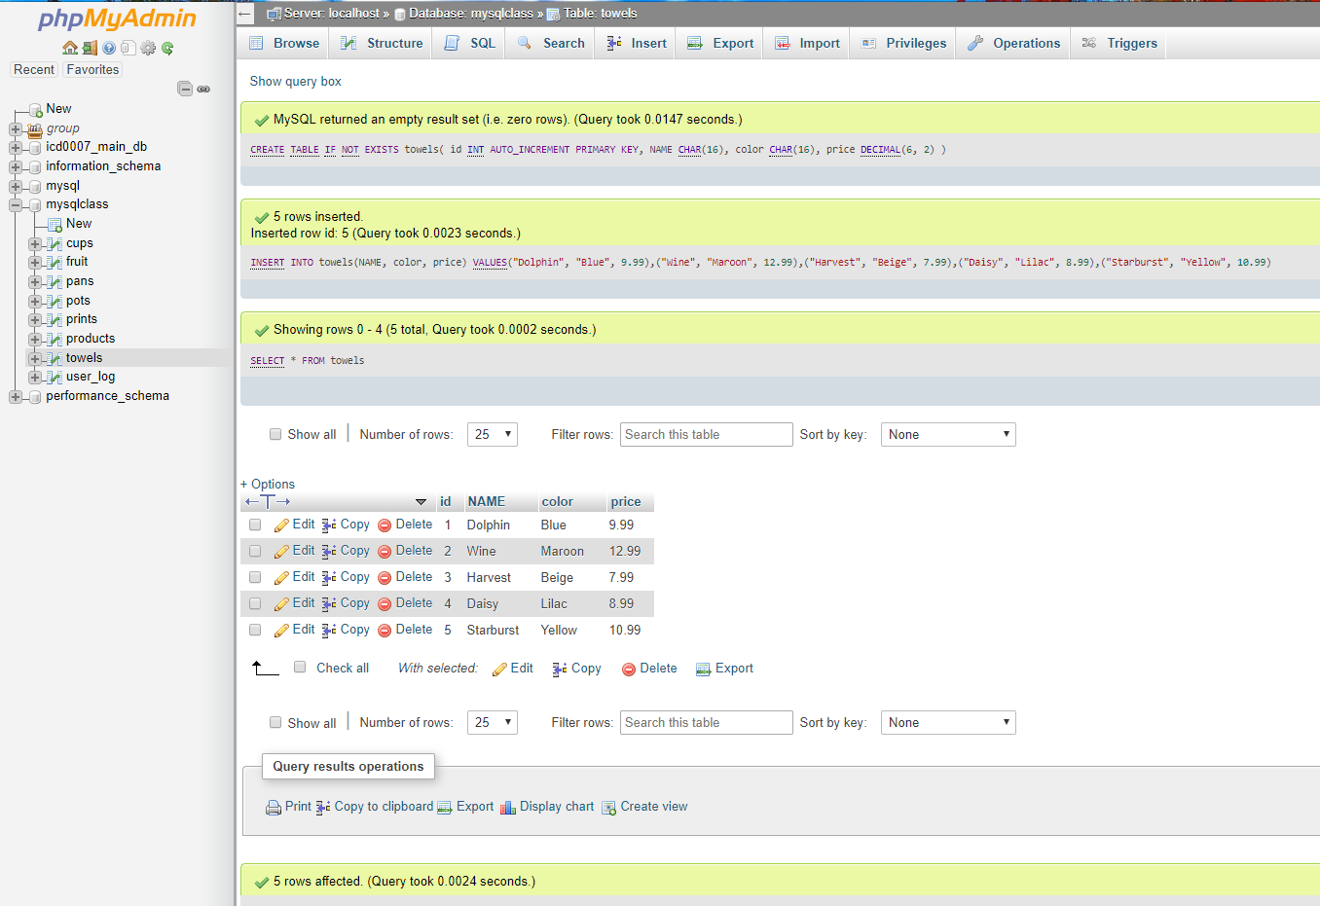
Updating columns

Slide 53
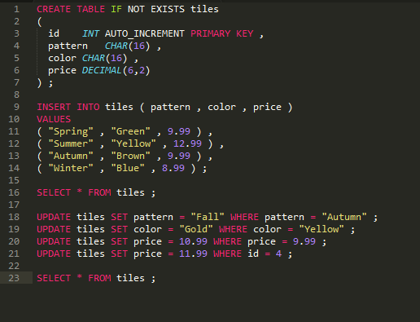
Updating fields

Slide 54
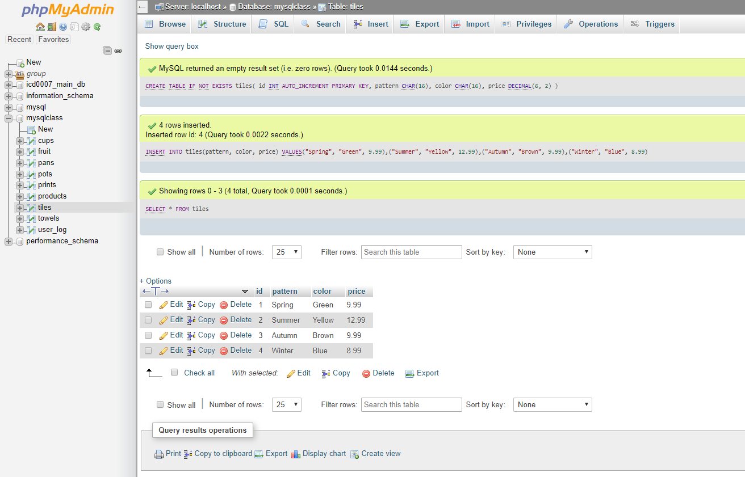
Updating fields

Slide 55
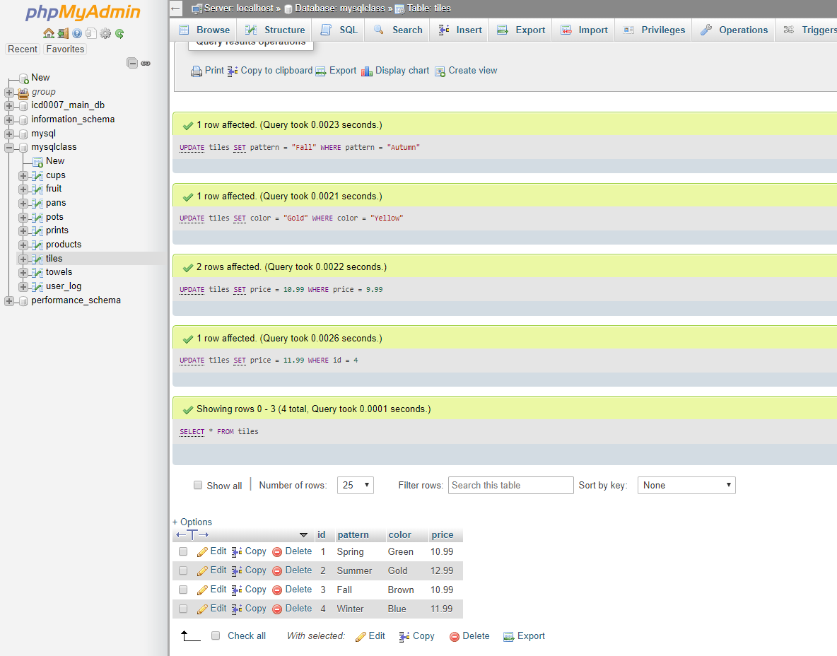
Updating fields(2)

Slide 56
PHP Classes and Objects Basics

Slide 57
Classes in PHP
Basic class definitions begin with the keyword class, followed by a class name, followed by a pair of curly braces which enclose the definitions of the properties and methods belonging to the class.
The class name can be any valid label, provided it is not a PHP reserved word.
A valid class name starts with a letter or underscore, followed by any number of letters, numbers, or underscores.

Slide 58
Simple Class Definition
<?php class SimpleClass { // property declaration public $var = 'a default value'; // method declaration public function displayVar() { echo $this->var; } } ?>

Slide 59
PHP Class/Object Functions
These functions allow you to obtain information about classes and instance objects. You can obtain the name of the class to which an object belongs, as well as its member properties and methods.
See more on Class/Object Functions here
For more on Object Oriented Programming in PHP and allied concepts:
See
https://www.tutorialspoint.com/php/php_object_oriented.htm

Slide 60
PHP Class/Object Functions
Object oriented programming is nothing but a technique to design your application. Application could be any type like it could be web based application, windows based application. OOP is a design concept. In object oriented programming, everything will be around the objects and class. By using OOP in php you can create modular web application. By using OOP in php we can perform any activity in the object model structure. There are many benefit of using oop over the parallel or procedural programming. Further in this part we will cover some basic of object and class and its implementation in php.
For more on Object Oriented Programming in PHP and allied concepts:
See
https://www.tutorialspoint.com/php/php_object_oriented.htm

Slide 61
PHP Function References
PHP is very rich in terms of Built-in functions. Follow the link for the list of various important function categories.
Fxn References

Slide 62
See you in the LAB session

